Slide 1


GitHub Repository https://github.com/MLDB2020/MLDB

Slide 2
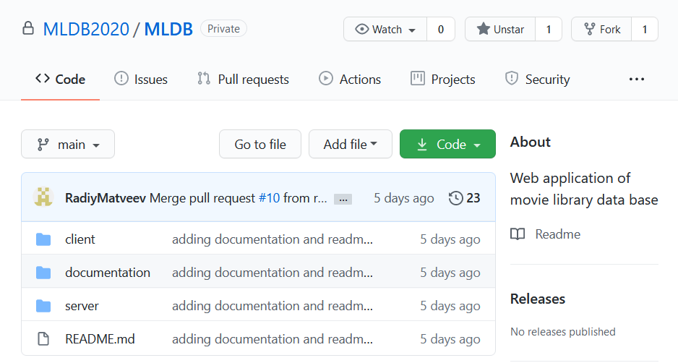
Root

Slide 3
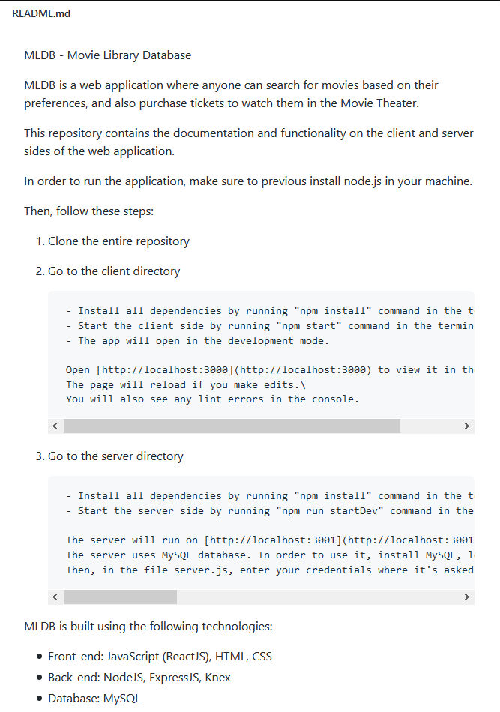
Readme

Slide 4
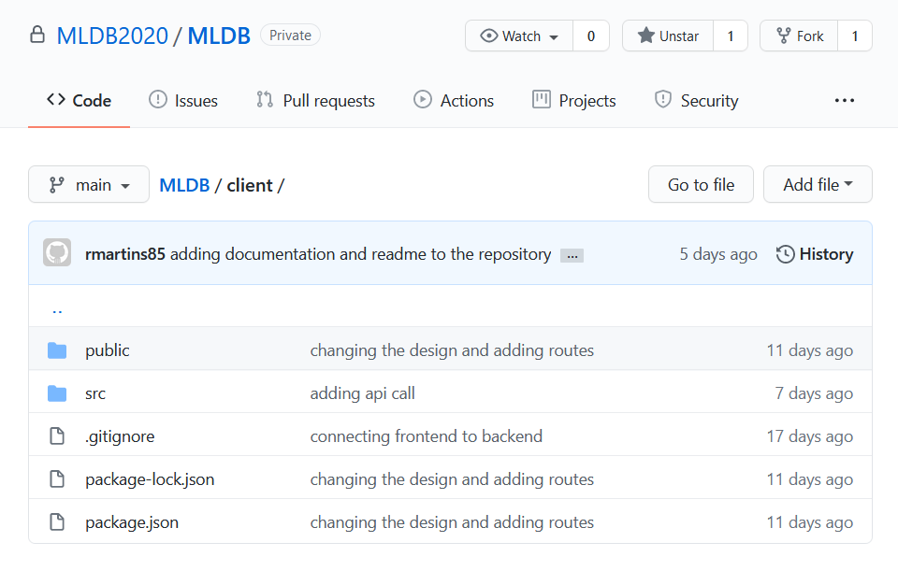
Client folder

Slide 5
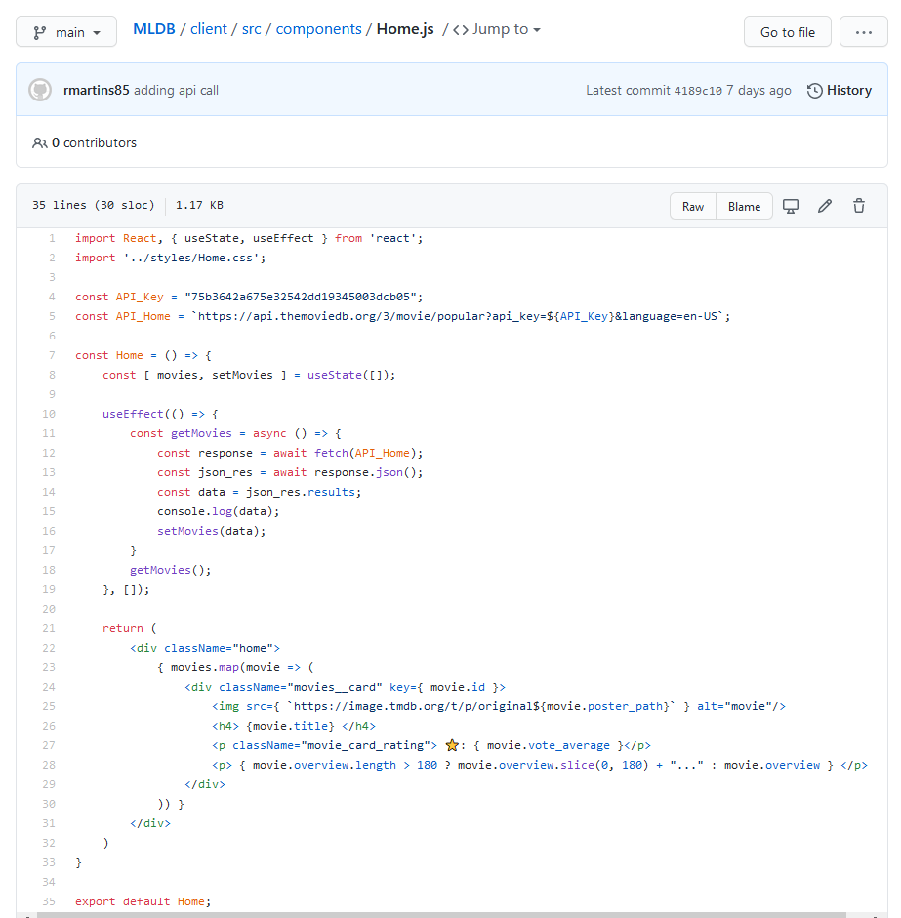
Home Component – Code Overview

Slide 6
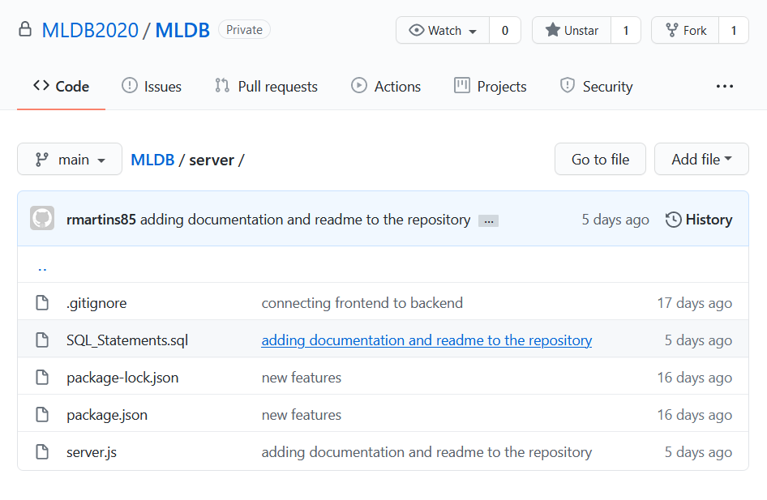
Server folder

Slide 7
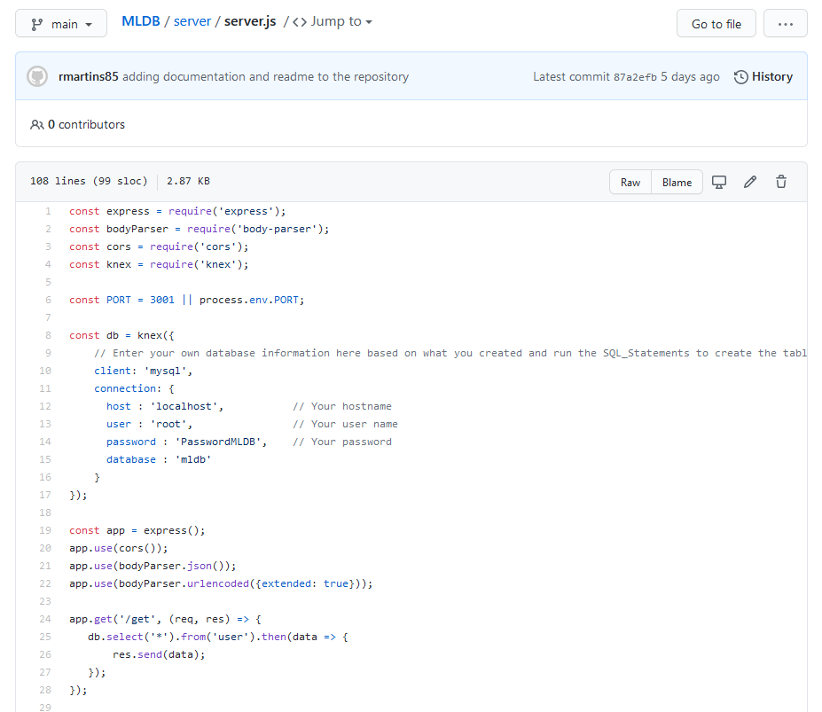
Server – Code Overview

